Slide 1
WeC4Communities (We Compute for our Communities): Community-Focused Computing for Minoritized Youth
Lori Pollock, Chrystalla Mouza, Rosalie Rolon-Dow and John Pelesko

Slide 2
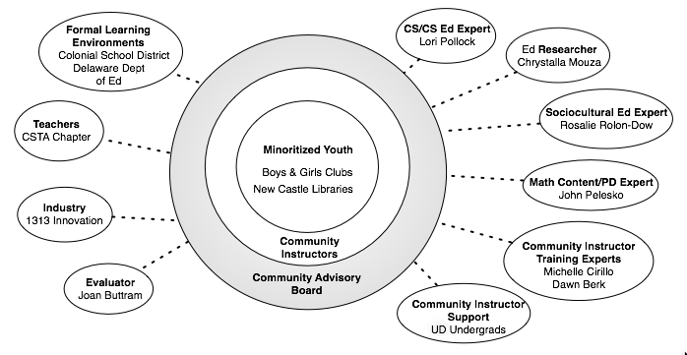
Partners

Slide 3
And More…
Project Advisors:
Liz Farley-Ripple, Partnership for Public Education, University of Delaware
Jeff Gray, University of Alabama
Luke Rhine and April McCrae, Delaware Department of Education
Randy Guschl, Delaware Foundation of Science and Math Education
Jon Manon, DFSME
Jamilia Riser, Delaware Math Coalition
Fred Hofstetter, UD College of Education

Slide 4
Project Overview: Goals
Facilitate culturally-responsive learning of key CS concepts and practices among underrepresented youth in grades 5-8; a period when youth naturally think about what they want to be when they grow up, but before they are presented with opportunities in high school to pursue STEM courses
Build youth (and community) knowledge around the potential positive impacts of computing on their local communities (e.g., the Nextdoor social network app for neighborhood recommendations, item exchanges and alerts
Increase participating youth knowledge, confidence, and interest in becoming creators of computing innovations
Strengthen participating youth mathematical skills through positive and intentional engagement with computing experiences.

Slide 5
Project Overview: Partners & Roles

Slide 6
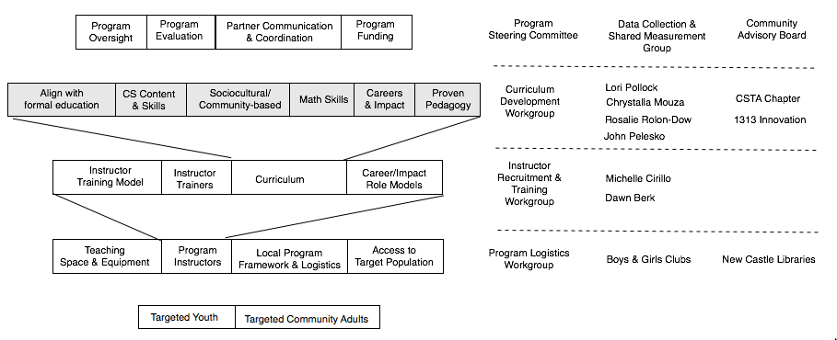
Project Overview: Partner & Roles

Slide 7
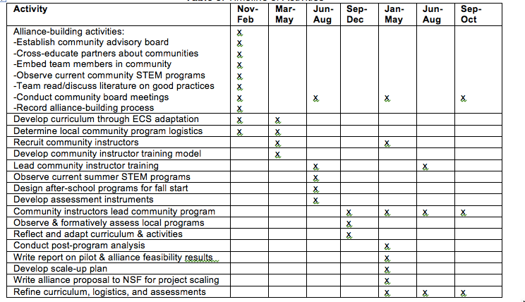
Project Overview: Timeline

Slide 8
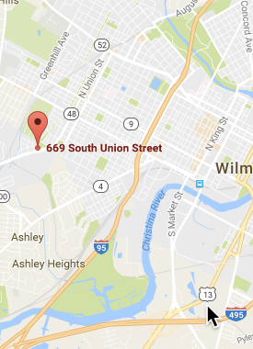
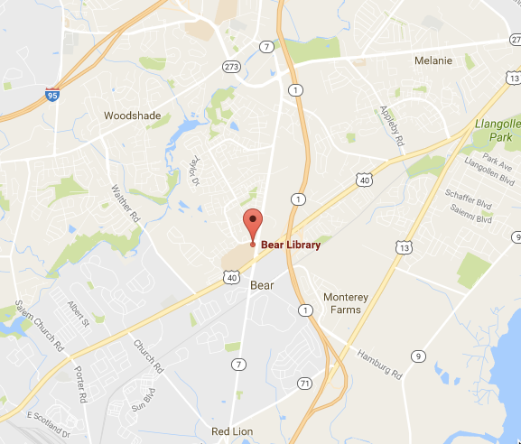
Project Overview: Pilot Sites
Clarence Fraim Boys and Girls Club
Bear Library

